Slide 1
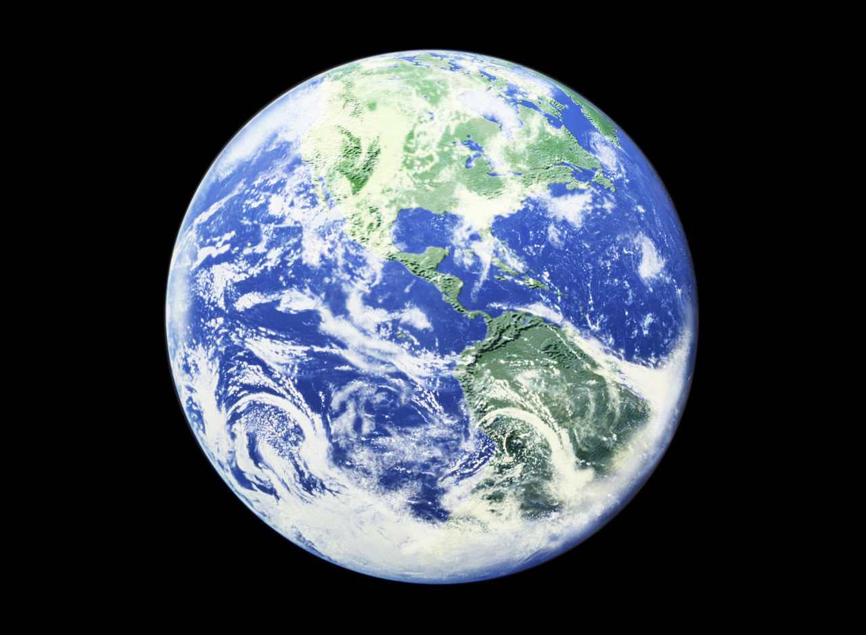
Advances in the Science of
Subjective Well-Being
Ed Diener, ISQOLS
October, 2015

Slide 2
Three Advances in the Science of Well-Being
Societal conditions matter, and beyond income. Happiness is not just personality
Subjective well-being has multiple benefits for the person and society
National accounts of well-being for policy have moved forward!

Slide 3
Societal Circumstances Matter a LOT to SWB! -- Not just personality -- Not just economic development

Slide 4
Society Can Make HUGE Difference

Slide 5
Example: Beyond Money
South Costa
Korea Rica
Household Income $ 46,500 12,800
Life Satisfaction 5.65 7.25
Positive Feelings .67 .88

Slide 6
Capture Quality of Life: Beyond Money (Diener & Seligman, 2005)
Predictors of Societal Life Satisfaction (Betas)
GDP/Capita .32
Corruption -.23
Can count on others .35
Life expectancy .19
N = 152 nations

Slide 7
Consequences of Happiness
To be stupid, selfish, and have good health are three requirements for happiness, though if stupidity is lacking, all is lost.
Gustave Flaubert

Slide 8
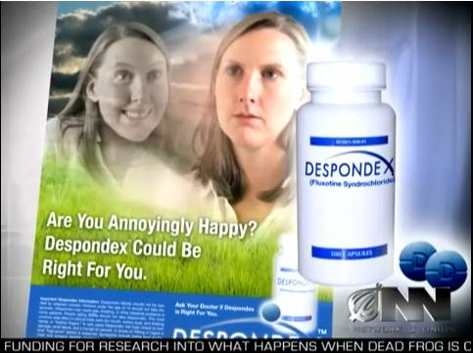

Slide 9
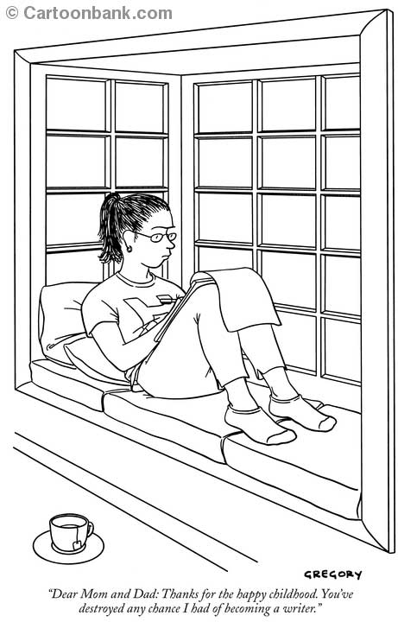

Slide 10
Outcomes Influenced by SWB
Health and longevity
Supportive social relationships
Work performance
Citizenship
Resilience

Slide 11
Longevity: The Nun Study

Slide 12
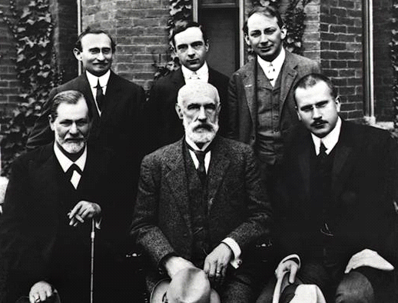
Longevity: Psychologists
Happier lived about 5 years longer– activated positive emotions
(Sarah Pressman,
Health Psychology)

Slide 13
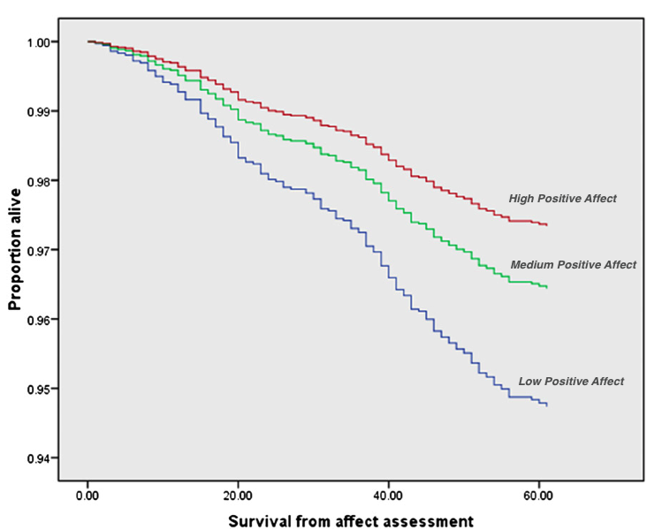
Proportion of individuals surviving by level of positive
(Steptoe and Wardle)

Slide 14
Health Outcomes
Happier people live longer
Have stronger immune systems
Less inflammation
Less cardiovascular disease
Better health behaviors

Slide 15
Conversely, the depressed and anxious more likely to suffer from:
Less exercise
Smoking
Excessive alcohol consumption
Unhealthy diet
Less seatbelt use

Slide 16
Wound Healing
Trait PA – quicker wound healing after stress
(Broadbent & Koschwanez, 2012)
Marital conflict experiment – slower wound healing and poorer immune response
(Kiecolt-Glaser et al., 2005)
Effects of psychological treatments on health markers
(Linden et al. 2007; Rutledge et al., 2013; Whalley et al., 2011; Orth-Gomer et al., 2009)

Slide 17
Hot off the Press Computer Self-Reported (Gallup)
Predicting Health Outcomes (r’s ) – State Level
Depression Happy
CHD .33 -.22*
Heart disease deaths .40 -.46
Physical activity -.45 .43
All p’s except * p < .05 Ford, Tay, & Diener, 2015

Slide 18
Estimates of Increased Longevity Due to SWB
Nuns 10 years
Pro Baseball players 7 years
Psychologists 5 years
Alameda County Residents 4 to 10 years
(Xu and Roberts)
Depression (Whooley, JAMA, 2008) - 5 years
Comorbid mental Illness -20 years

Slide 19
Social Outcomes of Happiness
More friends
Better marriages
Less divorce
More sex

Slide 20


We Like Happy People More Moaner Lisa Happy Lisa

Slide 21

Carol Diener 53 years ago— When Ed Met Her

Slide 22
Life Satisfaction Predicts Social Behavior Luhmann, Lucas, Eid, and Diener (2012)
People higher in SWB (life satisfaction) are more likely in ensuing years to:
Marry
Stay married
Controlling for personality and SES, replicated in 3 nations

Slide 23
Marriage and SWB: Selection and Social Effects

Slide 24
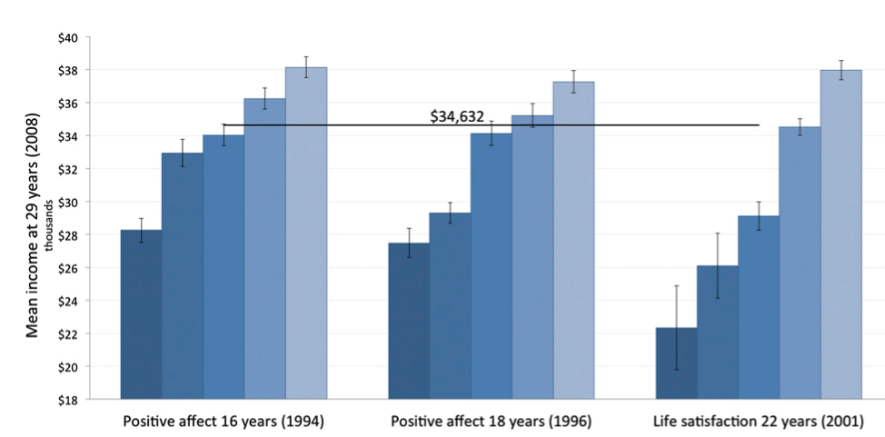
SWB at Work: Income
(DeNeve & Oswald Replication of Diener et al. study)
-- Early Subjectve Well-Being and Later Earnings

Slide 25
Work Satisfaction and Successful Organizations: Gallup Study: 141,900 employees in 2,178 work units of 10 large companies (Manufacturing, retail, etc.) Time 1 Time 2
Positive Work Attitudes
.11
Financial Performance
.26
Employee Retention
.20
.23
Customer Loyalty
.08

Slide 26
Longitudinal Research: Worker Satisfaction & Firm Value Alex Edmans (Wharton)
Time 1 Time 2
Stock
Satisfied Share
Workers Prices
Rise
More

Slide 27
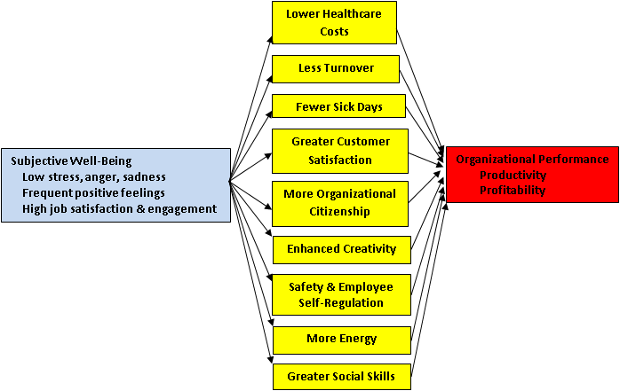

Slide 28
Tough Old Boss
I don’t care if my workers are happy; I just want them to work hard. They can have fun on their own time; they are here to work.

Slide 29
High Subjective Well-Being is Good for the Individual, and Good for Society. It Helps People Function Better!
Health and longevity
Supportive relationships
Work performance
Helping others
Resilience

Slide 30
Optimal Happiness

Slide 31
National Accounts of Well-Being Robert Kennedy, 1968
Too much and for too long, we seemed to have surrendered personal excellence and community values in the mere accumulation of material things. Our Gross Nation Product . . . counts air pollution and cigarette advertising, and ambulances to clear our highways of carnage. . . . Yet the gross national product does not allow for the health of our children, the quality of marriages, the intelligence of our public debate or the integrity of our public officials. It measures neither our wit nor our courage, neither our wisdom nor our learning, neither our compassion nor our devotion to our country, it measures everything in short, except that which makes life worthwhile.

Slide 32
National Accounts of Well-Being
Tracking well-being in nations (including counties, cities, etc.) for input to policy deliberations
Diener, E. (2000). Subjective well-being: The science of happiness, and a proposal for a national index.
American Psychologist, 55, 34-43.
Diener, E., Oishi, S., & Lucas, R. E. (2015). National accounts of subjective well-being. American Psychologist,70, 234-242.

Slide 33
Why Accounts of SWB?
Subjective well-being appears to have desirable and beneficial consequences
Citizens highly value “happiness”
-- It is democratic
3. It broadly reflects many aspects of quality of life in societies, not just GDP

Slide 34
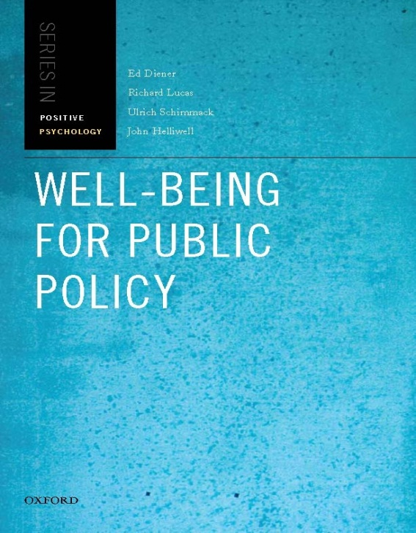
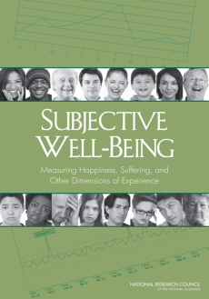

Very Brief History of Ed Diener & National Accounts of SWB
Early surveys of societal life satisfaction (largely ignored?)
1990 Economists hate Ed Diener
2000 American Psychologist article
2003 Diener talks at the World Bank
2005-2007 Diener coordinates U Penn program on indicators
2008 Diener talks to UN Development Program
2009 Diener et al. book on SWB and policy
2010 David Cameron UK announcement
2013 European Union Module on Subjective Well-Being
2014 41 nations adopt some measure of SWB
National Academy of Sciences Report
OECD Guidelines for SWB

Slide 35
Nations with Some Government Measurement of Subjective Well-Being
Australia
Austria Belgium Finland Iceland
Bhutan
Bulgaria
Canada
Chile
Croatia
Cyprus
Czech Rep.
Denmark
Estonia
France
Germany
Greece
Hungary
Ireland Italy
Japan
Latvia
Lichtenstein Netherlands Norway
Lithuania
Luxembourg
Malta
Mexico
New Zealand
Poland Switzerland
Portugal
Romania
S. Korea
Slovakia
Slovenia
Spain
Sweden
United Kingdom
United States

Slide 36
What Societies are Happiest? International Differences in Positive Affect
World Countries & Positive Affect
0.00 to 0.65
0.65 to 0.75
0.75 to 0.86
No data

Slide 37
Some Features of the Happy Society -- Diener Lab Findings
Economically developed (Diener)
Progressive income tax (Oishi & Diener)
Human rights protected (Diener, Diener, & Diener)
Low inequality (Oishi & Diener)
Income redistribution buffers income inequality (Zyphur, Tay, & Diener)
Low corruption (Tay, Herian, & Diener)

Slide 38
Some Other Features of the Happier Society
Clean air (e.g. Luechinger)
Green space (e.g., White)
Active commuting (e.g., Martin et al.)
Job programs (Easterlin)
Income security programs (Radcliff)
Caregiver programs (Sorenson)

Slide 39
Equality, welfare benefits, progressive taxation, job training, clean air, and human rights IS IT A LIBERAL UTOPIA? (Anathema to Republicans?)
BUT ALSO
Low Corruption
Efficient Government
Low Crime
High Income

Slide 40
Conclusions
SWB reflects specific aspects of societal quality of life
SWB benefits people in terms of health, relationships, citizenship, & productivity
Measuring SWB nationally can give valuable information to policy makers & leaders

Slide 41
We have made progress on implementation of the measures. Now can we get policy makers to take them seriously and use them!?!?

Slide 42
Policy Successes
IAPT UK
Improved Access to Psychological Therapies
Qaly UK
Adjusting research dollars to various diseases based in part on their effects on subjective well-being of the person, not just healthy life years
Welby
UK creation of Well-Being adjusted Life Years assessment for social and health policy making

Slide 43

Thank You!!
Questions?

Slide 44
SWB is Very Important to People: Importance Ratings (1-9)
Happiness Wealth Health
OVERALL
(28 nations) 8.0 6.8 7.9
USA 8.1 6.7 7.6
China 7.3 7.0 7.8

